Slide 1
Identity Management Implementation and monitoring
Presented by: Tshepo Kapa and Usheer Sing

Slide 2
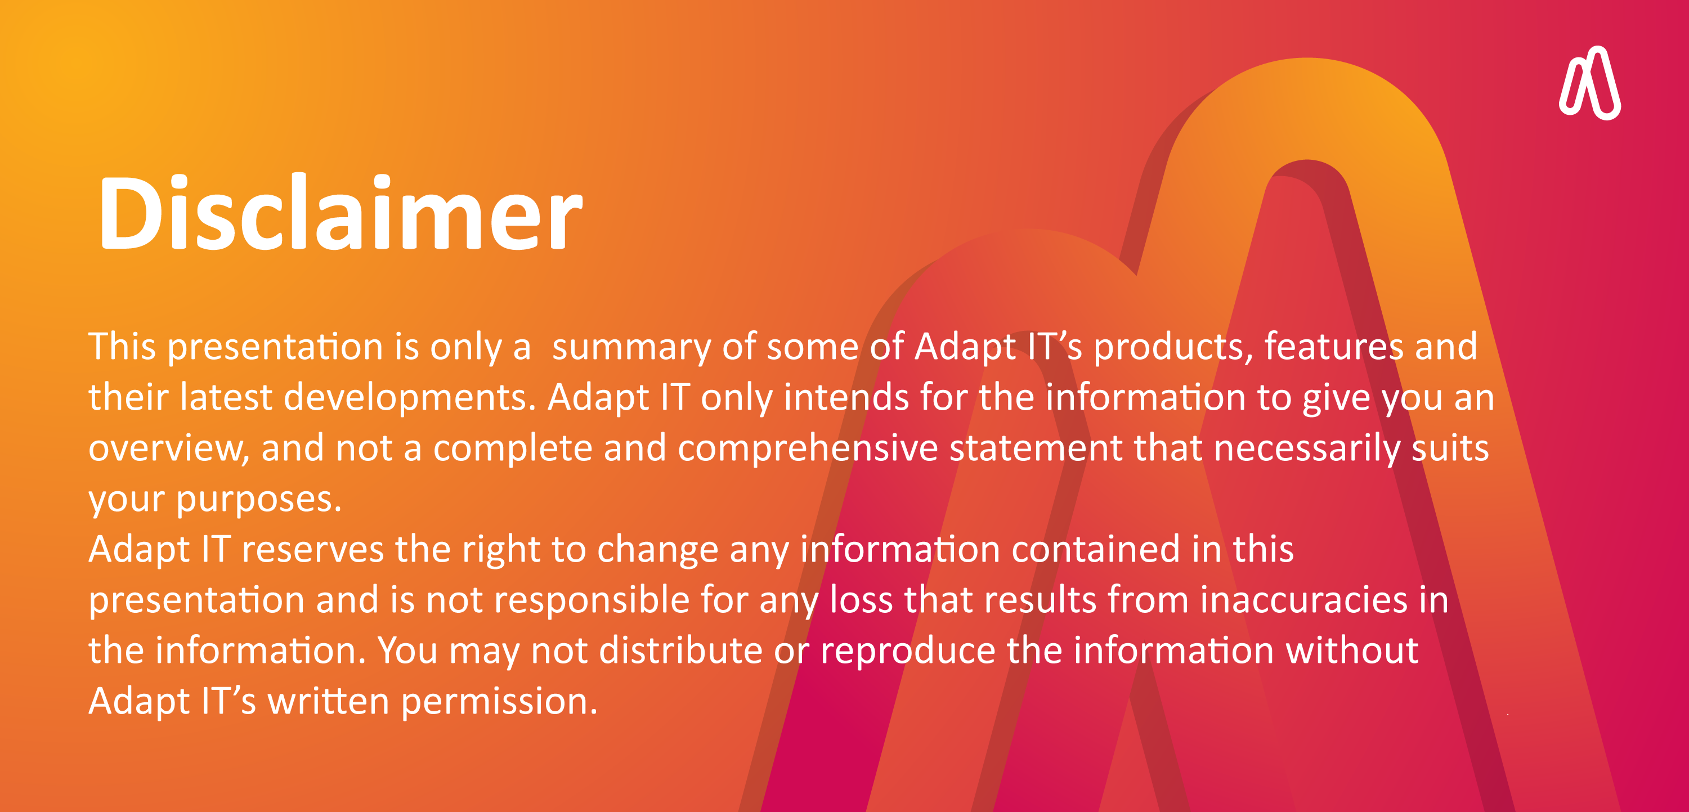
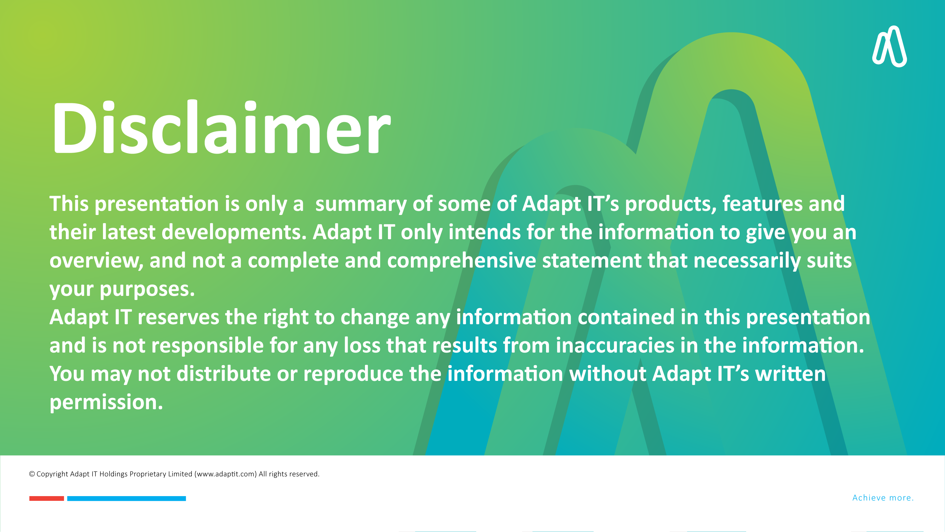

DISCLAIMER
This presentation is only a summary of some of Adapt IT’s products, features and their latest developments. Adapt IT only intends for the information to give you an overview, and not a complete and comprehensive statement that necessarily suits your purposes.
Adapt IT reserves the right to change any information contained in this presentation and is not responsible for any loss that results from inaccuracies in the information. You may not distribute or reproduce the information without Adapt IT’s written permission.

Slide 3

Introduction to Identity Management
Components of IAM
Implementing IAM
Key Identity-Related Risks for ITS Systems
Identity and Access Management (IAM) Best Practices
Essential Monitoring and Security Safeguards
Conclusion & Key Takeaways
Table of contents

Slide 4
Introduction to Identity Management

Slide 5

What is Identity Management?
Definition:
  Identity Management (IdM/IAM) is a framework of policies and technologies to ensure that the right individuals have access to the right resources at the right times for the right reasons.
Importance:
  Security: Protects sensitive information and systems from unauthorized access.
  Compliance: Helps organizations meet regulatory requirements.
  Efficiency: Streamlines user access processes, reducing administrative overhead.
  User Experience: Enhances user satisfaction by providing seamless access to necessary resources.

Slide 6
Components of IAM

Slide 7
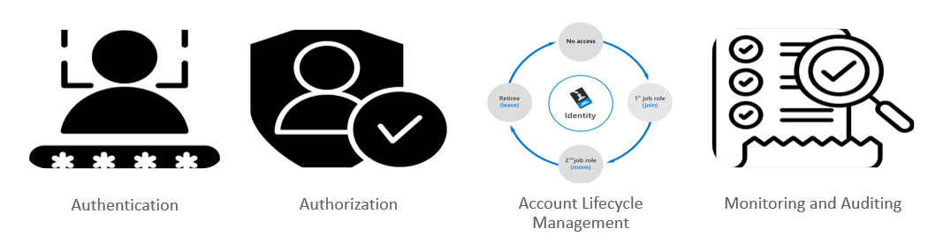
Key Components of Identity Management
Authentication: The process of verifying the identity of a user or system. Methods: Passwords, biometrics, multi-factor authentication (MFA), single sign-on (SSO). | Authorization: Determines what an authenticated user is allowed to do. Role-based access control, attribute-based access control and policy-based access control. | User Lifecycle Management: Managing user identities from creation to deletion. Processes: Onboarding, role changes, offboarding, and access reviews. | Auditing: Regularly audit user lifecycle processes to ensure they are being followed correctly.

Slide 8
Steps for building an IAM architecture
Step 1: Assess and Define Requirements
Identify Business Needs: Understand the specific business requirements and objectives for IAM.
Evaluate Current State: Assess the existing IAM infrastructure and identify gaps.
Define Scope and Goals: Clearly outline the scope, goals, and success criteria for the IAM implementation.
Step 2: Design the IAM Architecture
Select IAM Components: Choose the appropriate IAM components (e.g., identity providers, authentication services, access control engines).
Integration Planning: Plan how the IAM system will integrate with existing applications and infrastructure.
Security and Compliance: Ensure the design meets security and compliance requirements.
Step 3: Implement and Test the IAM Solution
Deploy IAM Components: Install and configure the selected IAM components.
Integration and Customization: Integrate the IAM system with existing systems and customize it to meet specific needs.
Testing and Validation: Conduct thorough testing to ensure the IAM system functions correctly and meets the defined requirements.

Slide 9







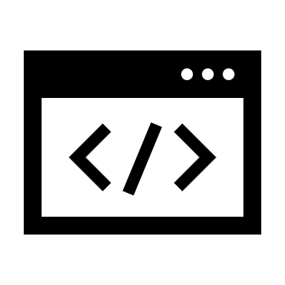
Overview of Identity Management Architecture
Identity Providers (IdPs):
Systems that verify and store user identities (e.g., LDAP, Active Directory, Okta).
Authentication Services:
Methods to confirm user identities (e.g., passwords, MFA, biometrics).
Access Control Engines:
Enforce policies to ensure users access only authorized resources. E.g. Ping Identity, ForgeRock, CyberArk, Wallix
Identity Repositories:
Centralized databases for storing identity information. (OID, AD, LDAP)
Integration Points
Oracle Forms:
Integrates with IAM for identity management, SSO, and identity governance.
IAM Cloud Service:
Provides identity management and access control capabilities.
USER
Auth
Access Control
ID Repository
Applications and Information

Slide 10
Key Identity-Related Risks for ITS Systems

Slide 11
Key Identity-Related Risks for ITS Systems
5. Unauthorized Account Creation & Access
4. Session Hijacking & Man-in-the-Middle Attacks
3. Phishing & Social Engineering Attacks
2. Privileged Account Misuse
1. Stolen or Weak Credentials
Notes:
1. Attackers can steal passwords using phishing, malware, or brute-force attacks.
2. Admin or faculty accounts have high privileges, which makes them the top targets for hackers, If compromised, attackers can access critical ITS data, modify grades, or steal research.
3. Cybercriminals trick users into revealing login credentials through fake emails or websites and sometimes used Session Hijacking & Man-in-the-Middle Attacks to intercept user sessions and take control of accounts. Eg, A student logs into Wi-Fi at a coffee shop
5. The same hackers can create hidden admin accounts to maintain unauthorized access or even an insider threat can do that to maintain unauthorized access.

Slide 12
Identity and Access Management (IAM) Best Practices

Slide 13
To protect ITS systems, Institutions should follow these best practices:
Enforce Strong Authentication (MFA, Password Policies)
Implement Role-Based Access Control (RBAC)
Monitor and Audit Identity-Related Activities
Regularly Review Access Permissions
Automate Account Provisioning & Deactivation
Notes:
1. Require users to verify identity using Multi-Factor Authentication (MFA)
2. Implementing Role-Based Access Control (RBAC) helps in restricting access based on user roles to prevents unnecessary access to sensitive data.
3. We then need set up logs and alerts to detect unusual activity, such as repeated failed login attempts.
4. Conducting periodic audits helps to ensure users only have the necessary access, then we reduce the number of unnecessary user privileges to reduce risk.
5. Lastly, Automating account creation when users join and immediately revoke access when they leave can help protect IT Systems.

Slide 14
Essential Monitoring and Security Safeguards

Slide 15
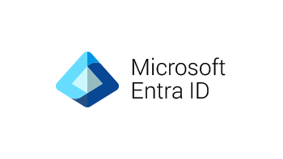
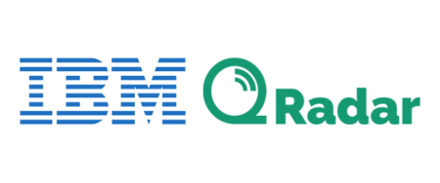
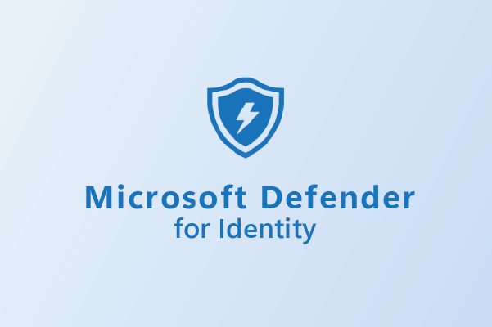


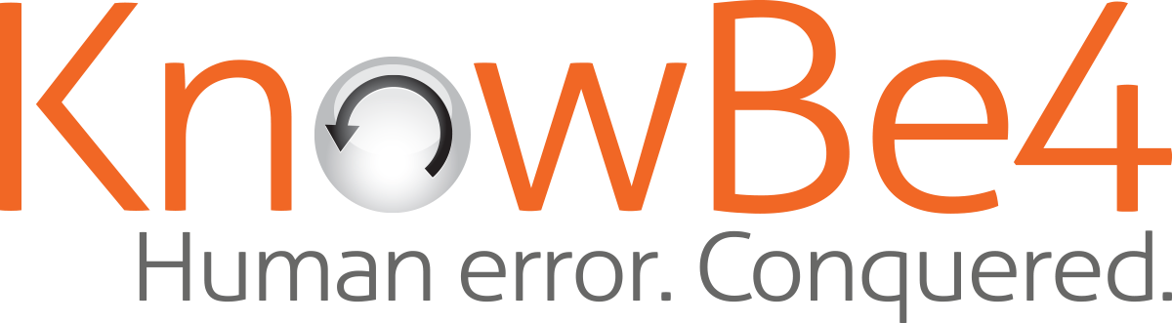

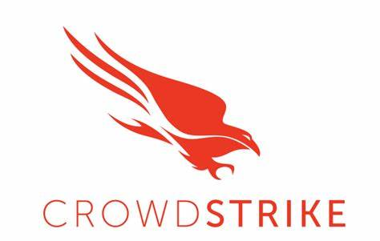

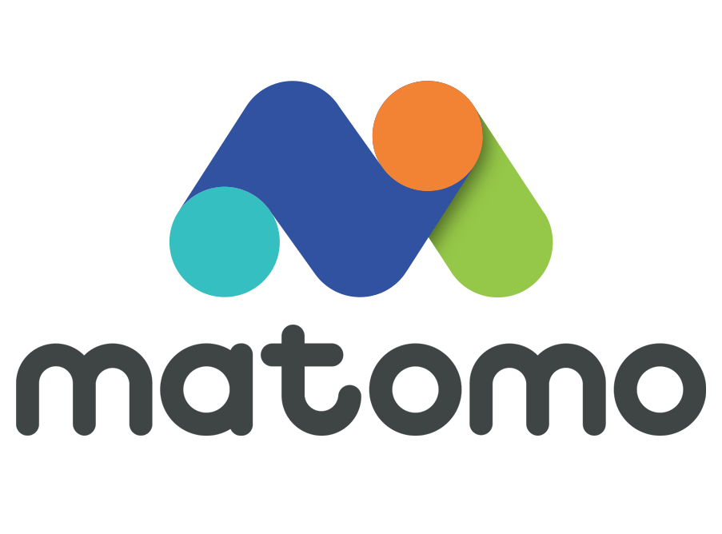

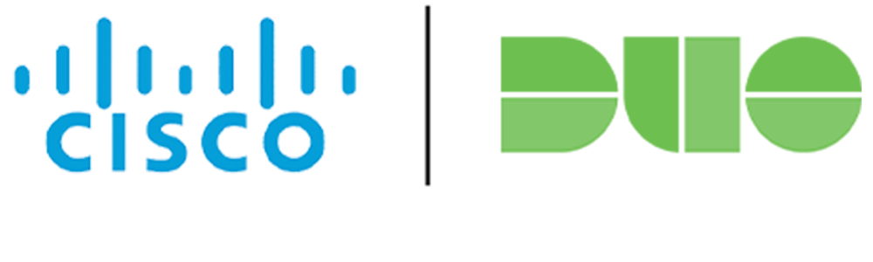
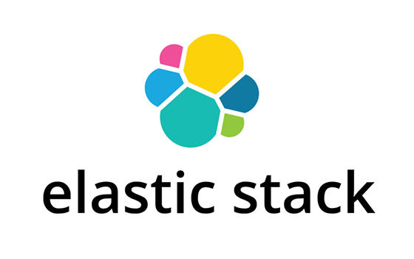
To enhance identity security, ITS systems should implement:
Real-time Log Monitoring & Security Analytics
Anomaly Detection for Unusual Login Attempts
Privileged Access Management (PAM)
Identity Threat Detection & Response (ITDR)
Incident Response Planning & User Awareness Training
Notes:
1. Real-time Log Monitoring & Security Analytics helps to Continuously monitor login attempts, access logs, and system activities for suspicious behavior.
2. Anomaly Detection for Unusual Login Attempts uses AI-powered analytics to spot strange behaviors, like a user logging in from a new country from another in a short period of time.
- This helps with impossible travel
3. Privileged Access Management (PAM) restricts and monitors the use of admin accounts to prevent misuse.
4. We Deploy advanced security tools that detect identity-related attacks in real-time and respond automatically.
5. Lastly, training users to recognize phishing attacks and then as an Organization, Develop a response plan for identity breaches to minimize damage.

Slide 16
Conclusion & Key Takeaways
Notes:
- Identity Management is the first line of defense in cybersecurity.
- Implementing IAM best practices significantly reduces the risk of account takeovers and unauthorized access.
- Last but not least, Continuous monitoring is crucial for detecting and stopping identity-based threats.
- N.B, Institutions must enforce strong authentication, access control, and monitoring to help secure these ITS environments.

Slide 17


Questions?

Slide 18
